Slide 1



MAJOR
Project Presentation
ON
ONLINE
VEHICLE RESERVATION
Presented By
Manish Shrestha
B.Sc.IT 6th Semester
LC Roll : 123151121
Univ. Roll : 1208009629

Slide 2
Introduction
Technically,
OVR is an online portal built with Java Servlet in Server-Side & MySQL as Database Management System.
Generally,
It’s a self drive rental vehicle concept.

Slide 3
WHERE I GOT THIS IDEA ? PROBLEM DEFINITION
Vehicle Owners problem,
- People buy vehicles but do not use regularly.
Users problem,
- Middle class peoples want to buy vehicle but costly.
- Want to self drive, as most as possible.
- Tourists like to drive, while visiting.

Slide 4
Objectives
- To change the trend of driver/passenger vehicle reservation.
- To make easy to rent a vehicle online.
- To digitalize all the paper work required.

Slide 5
Scope
Vehicle Owners,
- Can rent their vehicle online.
- According to their feasible Location & Time
Users,
Can book a self drive a rental vehicle online.
Without any third party in between.

Slide 6
Limitations
Its an online portal, so wouldn’t be efficient on areas where internet connectivity is a major problem.
A mobile app supporting will be a great add on.

Slide 7

System Requirement
HARDWARE
For Users, a PC, Tablet or any device that has support for browsers
For Server, a PC configured with minimum:
Pentium IV Processor
512 MB RAM
40 GB HDD
Mouse/Keyboard
SOFTWARE
For Users, a Web Browser (eg; Firefox, Chrome, etc.)
For Server,
Web Server (Apache Tomcat Server + JRE + MySQL Server)

Slide 8
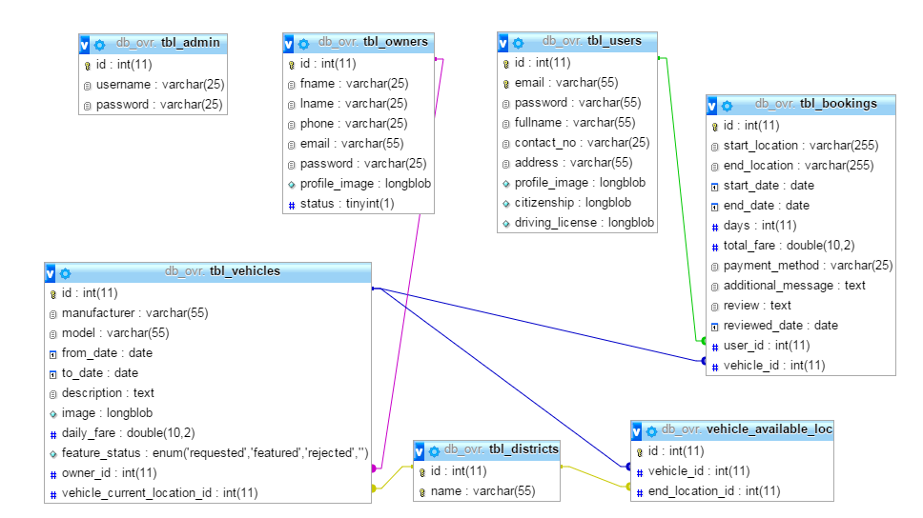
ER - Diagram

Slide 9
Flow Chart (Administrator)
Login Page
If
User/Pass
Correct?
No
Yes
Security
Vehicle Owners
Feature Vehicle
Logout
Change Password
Block/Unblock

